Slide 1
Javaee assessment
PRESENTATION

Slide 2
Topics
Introduction
Architecture diagram
Code demo
Q&A

Slide 3
Introduction
Java ee-based application that integrates with a mongo database, utilizes REST endpoints, and employs containerization for deployment.
Pre-requisites :
Java 11 or higher
maven
Docker
Mongodb compass
Intelij or any ide of your choice

Slide 4

Architecture diagram

Slide 5
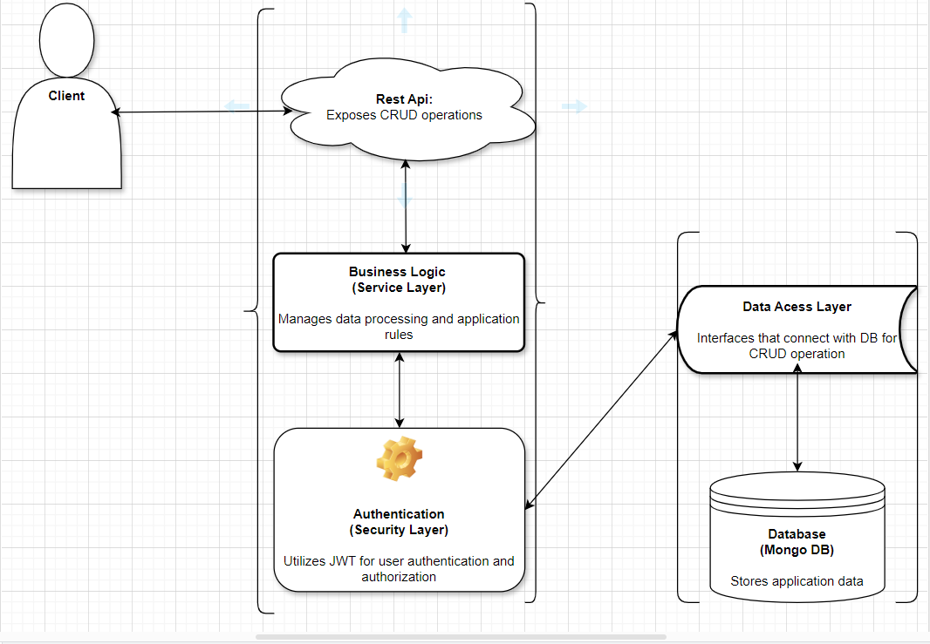

Slide 6
DEMO
PRESENTATION OF THE CODE

Slide 7
Q&A

